Slide 1
Daily report of Pi Logger system.
Hiroshi OKAMOTO.
On 2018-11-08

Slide 2
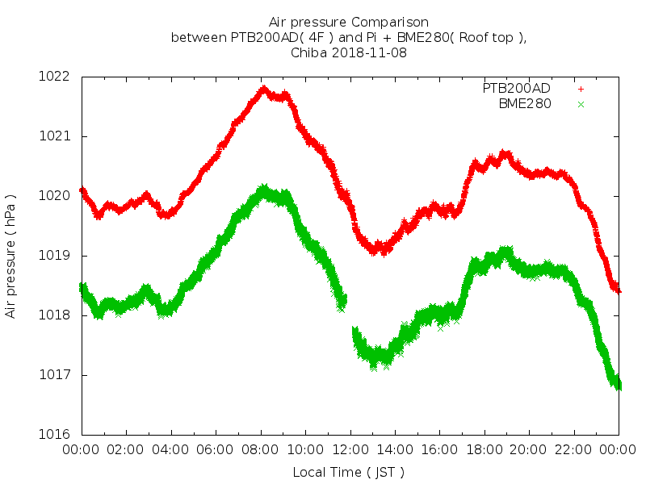
Air Pressure

Slide 3
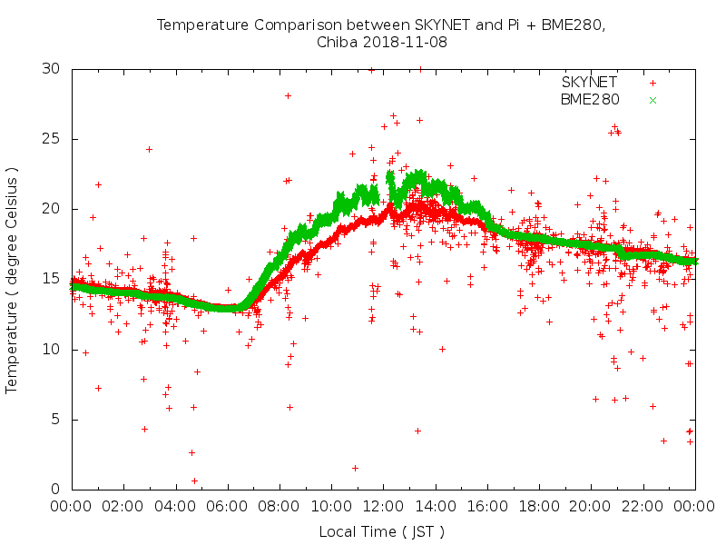
Temperature

Slide 4
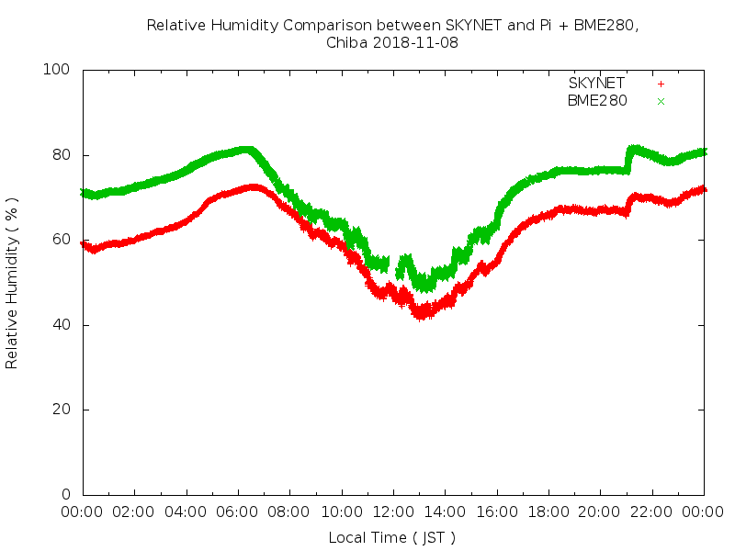
Relative Humidity

